Slide 1
Club Organization & Programming
Dorestal Family
Venus, Samantha, Sabine
Southern Area Coordinators

Slide 2
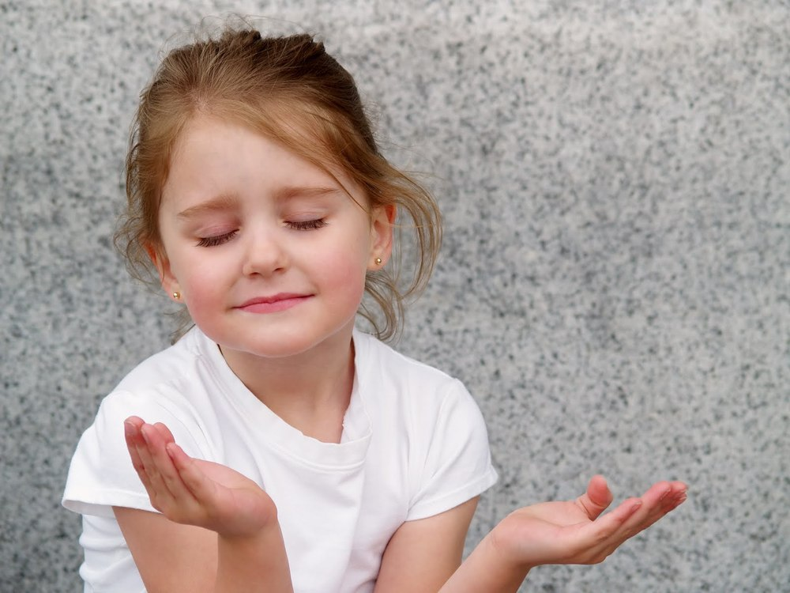
Introduction & Opening Prayer
This Photo by Unknown Author is licensed under CC BY-SA-NC
This Photo by Unknown Author is licensed under CC BY

Slide 3
How to Start an Adventurer Club
Talk to your Pastor
Connect with your Conference Leaders (Adventurer Area Coordinator)
Elect a Director/ Associate Director
The nominating committee/church board will recommend the Adventurer Club Director /Associate Director

Slide 4
Form an Adventurer Club Executive Committee
In a large church, the committee may be helpful. Involve the Adventurer Club leadership, Pastor, Kindergarten/ Primary Sabbath School Leader, Church School Teacher(s) of Adventurer age children, Adventurer parents. The Adventurer Director is chairperson.
This group sets major policies for operation, goals, objectives, and coordinates the club calendar with church calendar. This committee can give direction on the selection of additional staff.

Slide 5
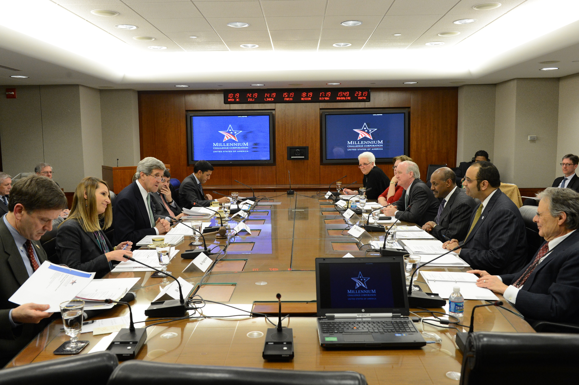
Church Board Authorization
Submit your plans to the Church Board. This is very important because this vote allows for you to let the Conference know that your club is official.
Fill out and send your Yearly Club Application to the Conference
This Photo by Unknown Author is licensed under CC BY-SA

Slide 6
How to Start an Adventurer Club cont’d
Gather
Gather Support of Parents
Meet with parents of Adventurer age children and have them spread the word.
Call
Call an Organization meeting
Schedule a meeting with those who would be interested in the Adventurer Ministry. Explain the goals of the ministry. Appeal for volunteers.

Slide 7
Inform the Congregation
Let the church know about the club and how it’s going to minister to families in church and the community.

Slide 8
Recruit Volunteers
Identify adults who love children and are willing to commit to the club.
Members of the Adventurer Team need to excited about kids
This Photo by Unknown Author is licensed under CC BY-SA

Slide 9
Participate in Adventurer Club Ministry Training
Adventurer Basic Staff training course
Put date on your club calendar
Encourage staff to attend
Learn from the seminars
Meet with others who are involved with Adventurers and share ideas
Those unable to attend, schedule time to share the basics, so you all can be on the same page

Slide 10
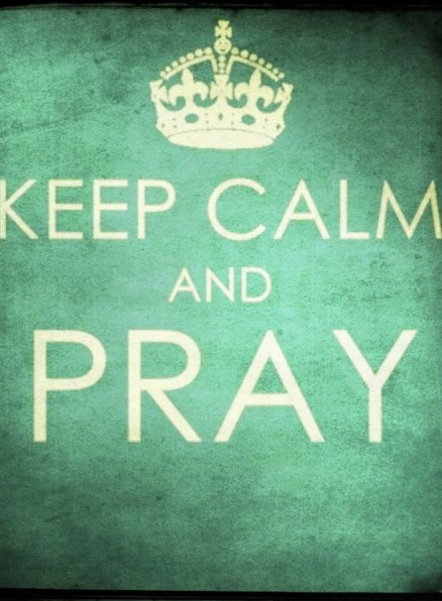
Pray
Pray for leaders
Pray for families
Pray that God will send the right people to join your Adventurer Club Team
This Photo by Unknown Author is licensed under CC BY-SA-NC

Slide 11
Adventurer Club Team
Responsible for planning the program (include parents)
The Director is selected by the nominating committee and voted into office by the church body.
The Assoc. Director/additional staff is selected through the nominating committee or the Director chooses his/or her Team
All members of the Team must work well with children, as well as being committed SDA members who demonstrate a growing friendship with Jesus.
This Photo by Unknown Author is licensed under CC BY-NC

Slide 12
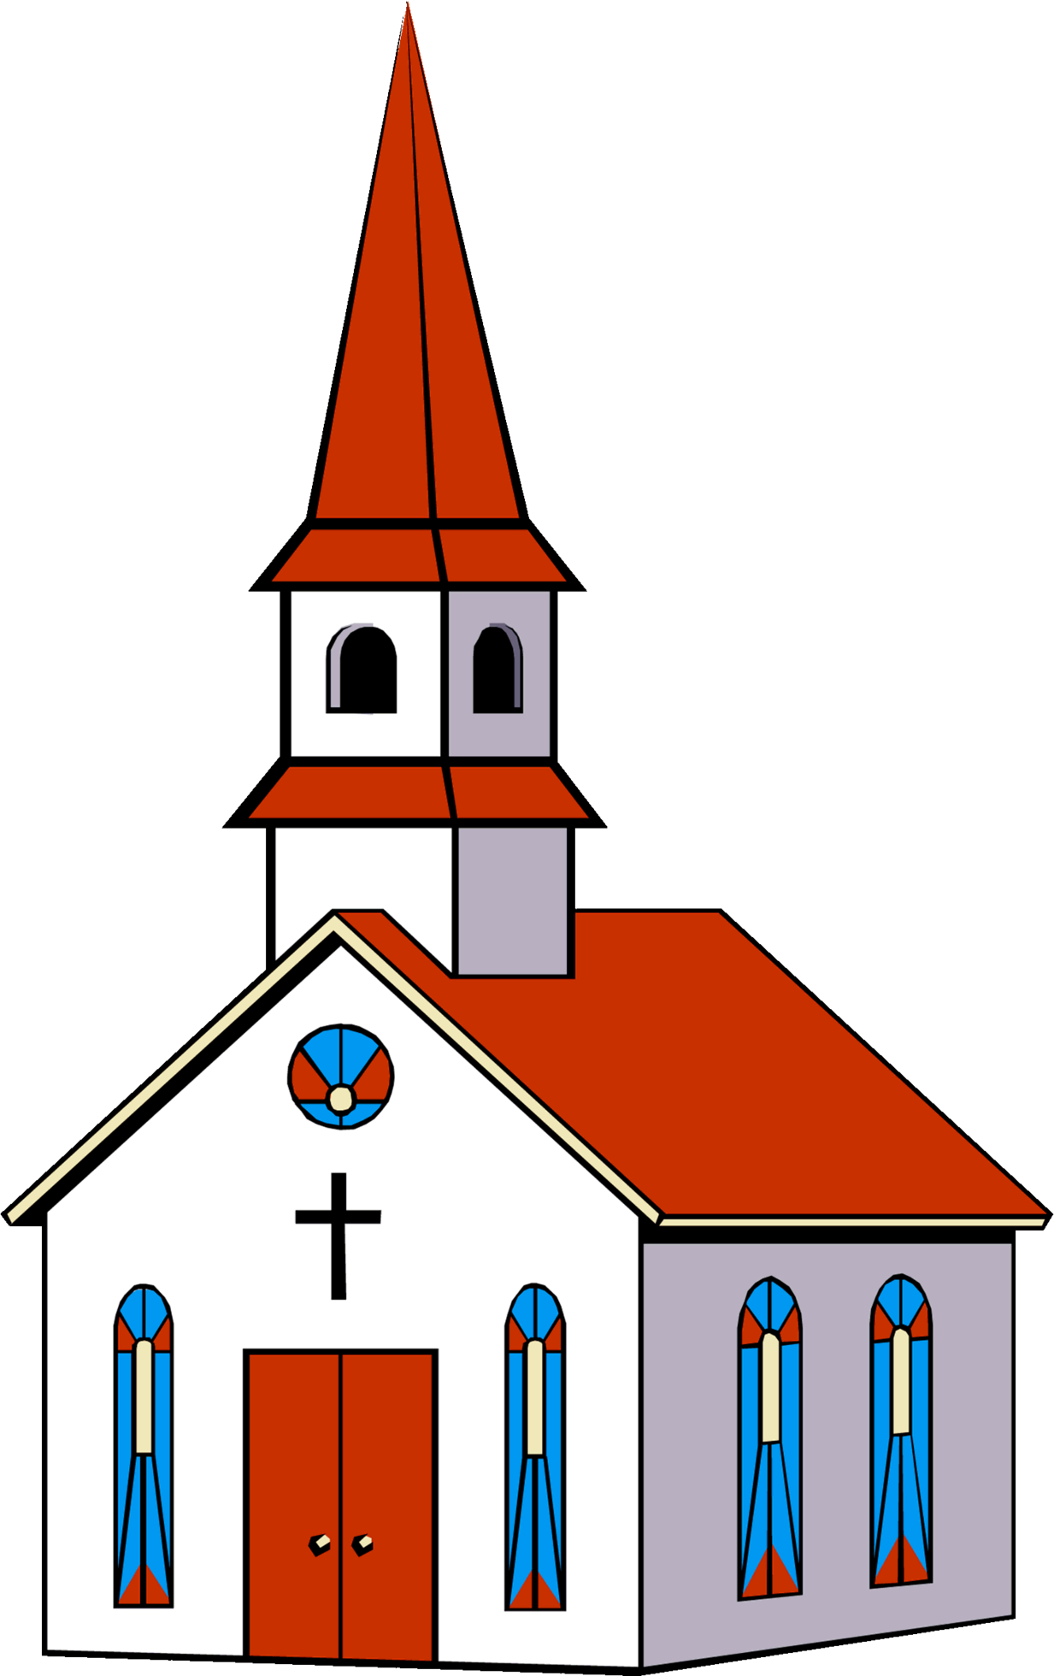
Denominational Flow Chart
Local Church: is governed by elected officers and departmental leadership. The Adventurer Club Director is elected each year.
Local Conference: is made up of all the local churches
Union: is a combination of several local conferences
NAD: is comprised of 9 North American Unions. Included countries are Bermuda, Canada, and USA. Headquarters is in Silver Spring, MD.
General Conference: is comprised of 10 divisions, coordinating church work worldwide. Headquarters is in Silver Spring, MD.
Local Church
Chesapeake Conference
Columbia Union
NAD
General Conference
This Photo by Unknown Author is licensed under CC BY-NC

Slide 13
Adventurer Forms
Resources | youth-ministries (ccsdayouth.org)
Club Yearly Application
Adventurer Registration Form
Adventurer Club Health Record
Induction Request Form
Quarterly Report Form

Slide 14
Planning the Yearly Calendar and Budget

Slide 15
ACTIVITY

Slide 16
Programming (Each level needs a Counselor)
Discovery
Adventurers
Baby Birds (1-2yrs)
Little Lamb (3yrs)
Curious Cubs (4yrs)
Eager Beavers (5yrs)
Busy Bee (1st Grade)
Sunbeam (2nd Grade)
Builder (3rd Grade)
Helping Hand (4th Grade)
Advanced Helping Hand(not quite ready for Pathfinders)
This Photo by Unknown Author is licensed under CC BY-SA

Slide 17
FIRST CLUB MEETING
Full of FUN and EXCITEMENT!!!
Everyone should be involved in the Activities
(Parents, Staff, and Children)

Slide 18
Club Meeting Outline
Opening Exercises
Fall in by classes
Pledges: American, Christian, & Bible
Adventurer Pledge & Law, Song
Prayer
Creative Worship
Sing a song
Story or object lesson or skit
Restroom Break
Classwork by level
Group Activity (Busy Bee to Helping Hand)
Choose one of the following:
Start a new award
Complete an award
Play a fun game
Craft
Clean up
Closing
Announcements
Prayer
Dismissal

Slide 19
Adventurer Uniform
The uniform makes the Adventurer Club real to its members, especially the children. The uniform becomes an emblem of a standard, builds loyalty to the club, and brings members into a sense of community. The uniform should always be neat, clean, and worn with pride.
Full dress uniforms should be worn for the following occasions:
Regular Adventurer meetings (as designated on the schedule)
Special services (Induction, Adventurer Day, Investiture, etc.)
Public gathering when any or all act as:
Ushers
Guards of honor
Color guards
When the club participates in community service activities, such as Ingathering, distributing food baskets, delivering bouquets, passing out literature, and singing bands
On occasions as specified by Adventurer staff officers
Adventurer Club Uniform | Club Ministries - North American Division

Slide 20
Do I have to buy a new uniform for my Adventurer?
Clubs have lots of options when it comes to uniforms. One option is to have a staff member who is responsible for measuring each Adventurer and ordering uniforms for each. Another option is to have parents purchase uniforms for their child(ren) that are in the club.
Here are some options that can reduce uniform expenses:
Provide rental options
Arrange a time for parents to trade uniforms
Set-up a system where the club loans out uniforms
The key to any of these options is to have a staff member who is responsible for implementing the plan your clubs adopts.
Adventurer Club Uniform | Club Ministries - North American Division

Slide 21
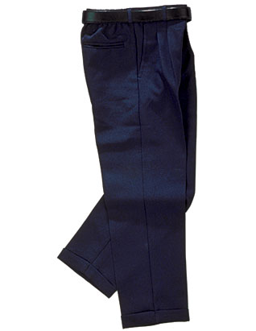
Chesapeake Class A Uniforms
Males
Light blue shirt, with shoulder epaulets, pockets
Navy pleaded pants
Black dress shoes (polished) with navy socks
Navy honor sash
Black belt, navy necktie
Burgundy Adventurer scarf with Adventurer slide
For Discovery club members: Light Blue scarf with discovery slide
For Master Guides: There is a Burgundy Color Adventurer Master Guide Scarf with stripes
Navy beret with Adventurer patch (as per club)
Adventurers | youth-ministries (ccsdayouth.org)

Slide 22
Chesapeake Conference Class A Uniform
Females
Light blue shirt, with shoulder epaulets, pockets
Navy pleaded jumper for girls and skirt for ladies
Black dress shoes (polished) with navy tights or stockings for ladies
Navy honor sash
Navy necktie
Burgundy Adventurer scarf with Adventurer slide
For Discovery club members: Light Blue scarf with discovery slide
For Master Guides: There is a Burgundy Color Adventurer Master Guide Scarf with a stripes
Navy beret with Adventurer patch (as per club)
Adventurers | youth-ministries (ccsdayouth.org)

Slide 23
RESOURCES FOR SUPPLIES
Advent Source –clothing, uniform patches, chips, awards, workbooks, etc.
Pathfinder Shirts-uniform, club crests, custom t-shirts, patches (Old Adventurer logo), pins, etc.
Chesapeake Conference- Conference patches for shirts

Slide 24
Class B Uniform
Club t-shirt with blue jeans, sneakers, and socks Adventurers | youth-ministries (ccsdayouth.org)

Slide 25
QUESTIONS & COMMENTS

Slide 26
CLOSING PRAYER
This Photo by Unknown Author is licensed under CC BY

