Slide 1

Never a Dull Moment
Javier Scharon
Chesapeake Conference

Slide 2

"Success isn't just about what you accomplish in your life; it's about what you inspire others to do."

Slide 3

What does your youth ministry look like?
Are you inspiring others?
How, or why not?

Slide 4

The Non-Neutral Environment a positive change

Slide 5
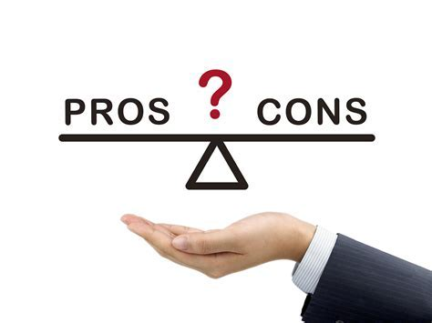
Pros and Cons of NNE's
Pros
You don’t know the results
Youth like to mix things up
Youth are energized
You can inspire others
Cons
You can go too far.

Slide 6

Break Out

Slide 7
"Young people come alive when there's a change from what is predictable.
In fact, you don’t create NNE's for young people, they will create non-neutral environments for you."
Case & Cisneros

Slide 8

Considerations for creating NNE's
Homeless Jeff debrief
How would your youth group react?
What are the risks?
What would parents say?
What would the rest of the church's reaction be?
Would this be over the top?
1. Identify what is neutral.
2. gradually create a NNE
3. NNE's vary by: age, individual, groups, settings.
4. Over the top is too far!
5. List the potential responses.
6. Need to debrief afterward.
7. It is risky
8. Foundation of relationships- Build up trust in the youth group and church before attempting NNE's that push people out of their comfort zone.

Slide 9

Breakout Time
Programs: 1. Youth Group
2. Friday Evening Bible Study
3. Saturday Night Social
4. Service Activities
5. Prayer experiences

Slide 10

Evaluate, Evaluate, and Evaluate
Evaluate your.....
Purpose: If you have a program and a non-neutral environment, but no purpose, the result is games or harassment. People either have fun but no growth, or they think you're just harassing them.
NNE: If you have a program and a purpose but no NNE, the result is plane BOREDOM.
Program: If you have a NNE with a purpose, but you don’t have a program where you can actually do it, the result is THEORY.

Slide 11

Breakout

Slide 12

If you have a program with a non-neutral environment and a purpose, the result is MINISTRY

