Slide 1
Planning & Leading Effective Worship Services
Pastor Josué Feliciano
Chesapeake Conference

Slide 2
What is Worship?

Slide 3
Worship is an encounter with God

Slide 4
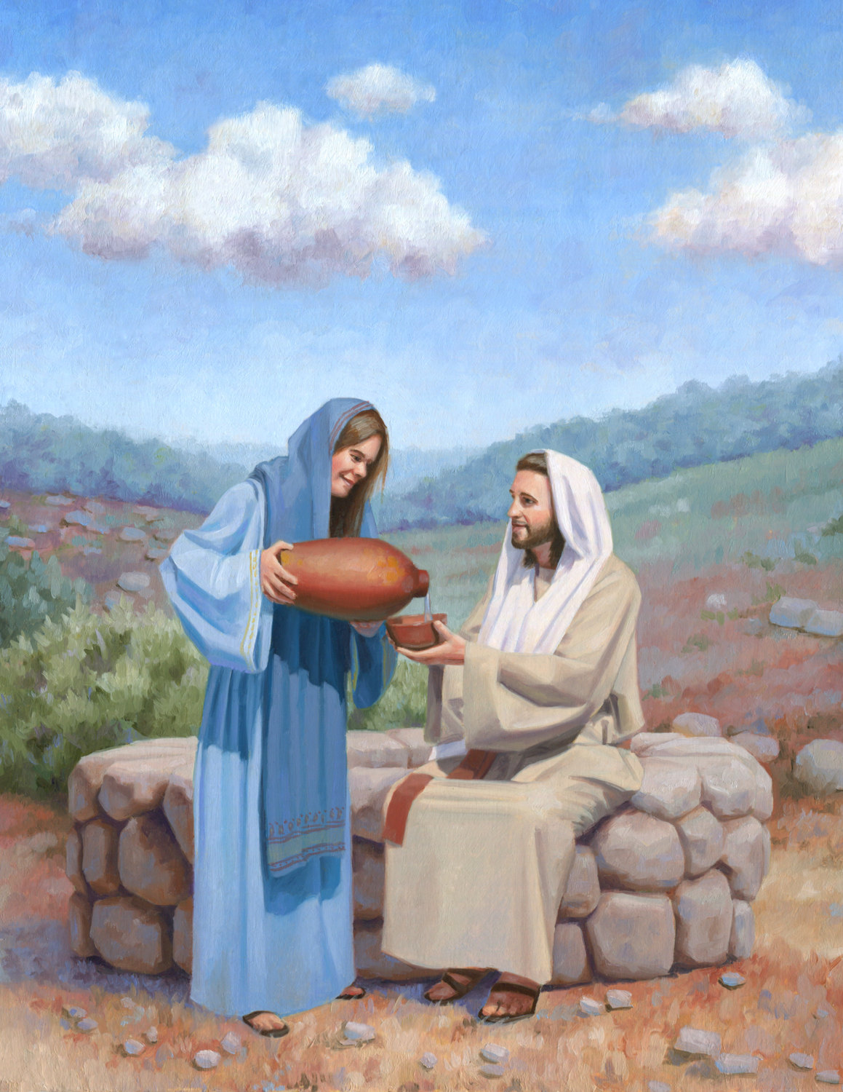
Christ’s Word on Worship
“You Samaritans worship what you do not know; we worship what we do know, for salvation is from the Jews. Yet a time is coming and has now come when the true worshipers will worship the Father in the Spirit and in truth, for they are the kind of worshipers the Father seeks. God is spirit, and his worshipers must worship in the Spirit and in truth.”” John 4:22-24
“You hypocrites! Isaiah was right when he prophesied about you: “ ‘These people honor me with their lips, but their hearts are far from me. They worship me in vain; their teachings are merely human rules.’ ” Matthew 15:7-9 NIV

Slide 5
What does Jesus tell us that impacts planning Worship?

Slide 6
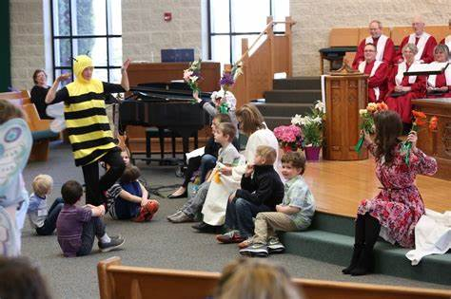
Four Learning Styles to Plan for Worship
Auditory - importance of hearing truth (informative)
Kinesthetic - wants to feel the worship (experience)
Visual - looking for something to visualize (spatial)
Musical - impacted by good music as ministry

Slide 7
What are the important principles to Worship?
Understanding your Audience
Music that prepares for Worship
Setting the tempo and tone for Worship
Ways of helping others get involved in Worship

Slide 8
Understanding your Audience

Slide 9
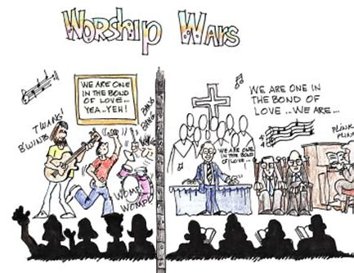
Who is your Audience?
What is the age of the majority of your audience?
What are their needs of the culture of that church or group?
What are the composition of the families?
What is the occasion for the worship engagement?

Slide 10
What could be some sources to help you find out information about the audience?

Slide 11
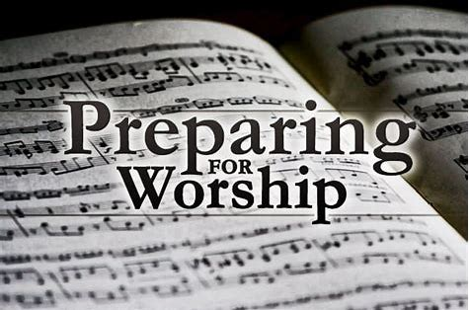
Music that prepares for Worship

Slide 12
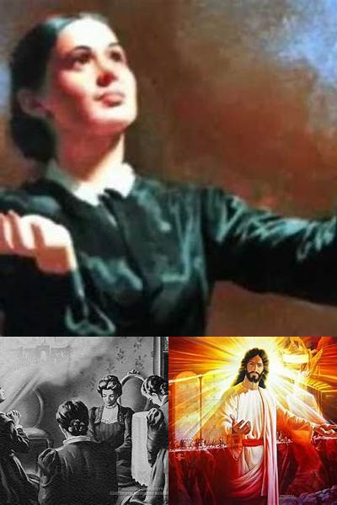
“Music forms a part of God’s worship in the courts above, and we should endeavor, in our songs of praise, to approach as nearly as possible to the harmony of the heavenly choirs. The proper training of the voice is an important feature in education, and should not be neglected. Singing, as a part of religious service, is as much an act of worship as is prayer. The heart must feel the spirit of the song, to give it right expression. ”
Christian Education, p.62

Slide 13
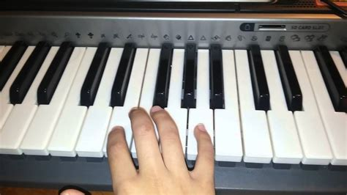
How to make the most of Music
Tie the songs to the theme of Worship
Use the more energetic songs at the beginning
Arrange the songs flow from higher to lower energy
This allows people’s attention to be focused on God and listening for the message from God

Slide 14
How has music helped your worship experience?

Slide 15
Setting the tempo and tone for Worship

Slide 16
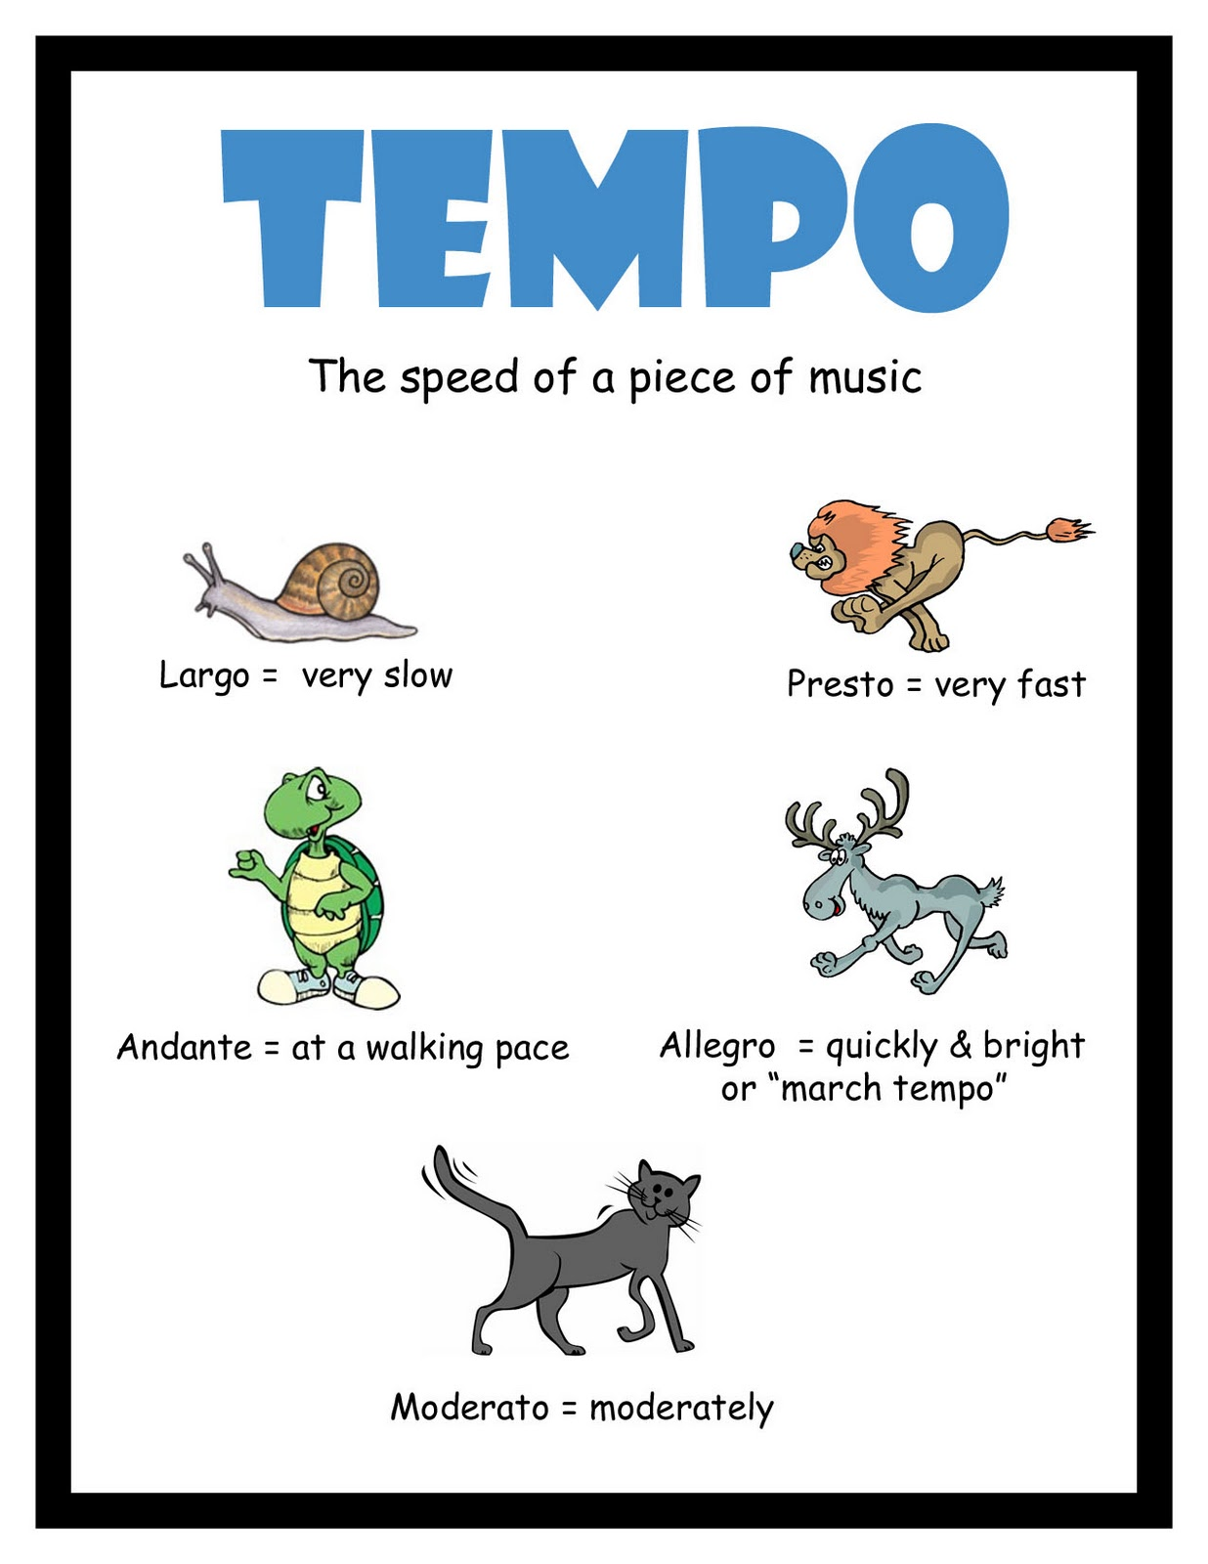
Setting the Tempo & Tone
Important to keep in mind your audience and setting
Start with questions that help people want to belong
Reward participation when volunteers needed
Recognize and appreciate people for sharing their talents

Slide 17
What would be some questions that would encourage participation?

Slide 18
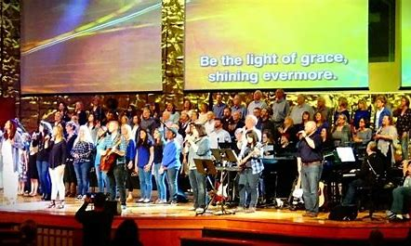
Ways of helping others get involved in Worship

Slide 19
Practical Ways of getting involvement
Announcements - Seek assistance with Fun things
Call outs - Who is here from Wilmington Church?
Invitations to have them share - Open Mic/Testimony
Participation in an object lesson, like
acting out or a learning experiment

Slide 20
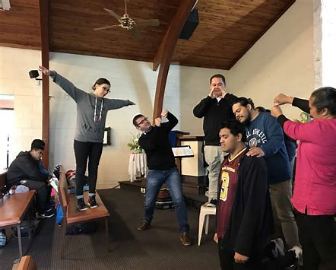
What are other creative way to get people involved in Worship?

Slide 21
Who are good people to help you plan for Worship?

Slide 22
Questions

