Slide 1

Ministry for Tecno- Postmodern Young People
Carl Rodriguez
Chesapeake Conference

Slide 2
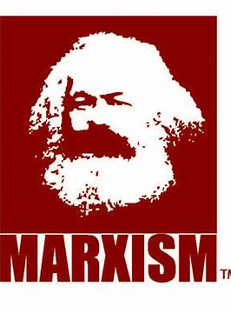
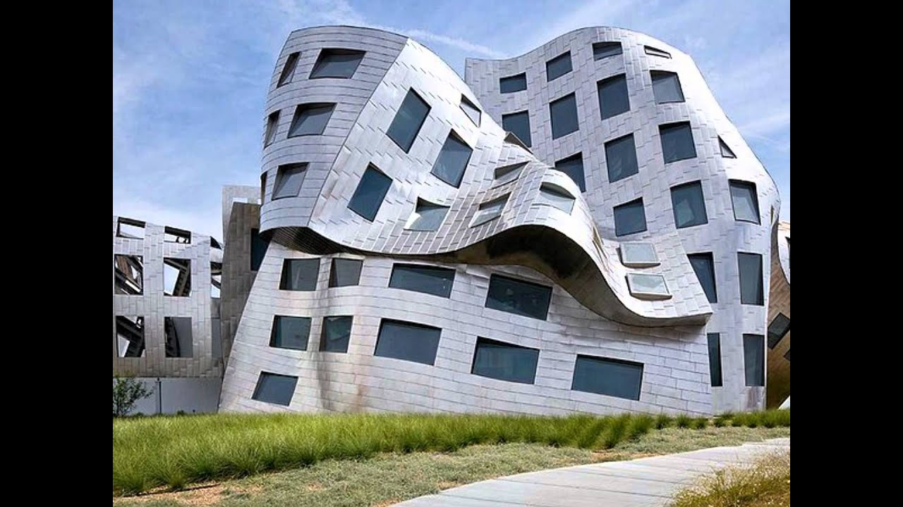
Review of How we got here
Modernism (Top-down) Industrial Age - - - - - > Post-Modernism (Side-to-side)
(1760’s – 1987 [Berlin Wall]) Deconstruction – From Europe → US (2020)
Government Movement Globalism
Communism, National Socialism → Anti-Christian One world government law, no God, no war
Free Market People’s Movement - Social Justice Free Market – Each nation should have – Unions, Labor Laws, Slavery – Brexit, Poland, Egypt, etc.
Christian Movement Christian Movement –> Techno-postmodern
- Sunday School (Church reading and writing) - Community
- YMCA (Young Men Christian Association) - Discipleship Funnel
- Visibility

Slide 3

Techno-Postmodern Approaches
Ministry of Community
Ministry of Discipleship
Ministry of Visibility

Slide 5

Break Out
Why is Community
(A place to belong)
so important for today’s young people?

Slide 6
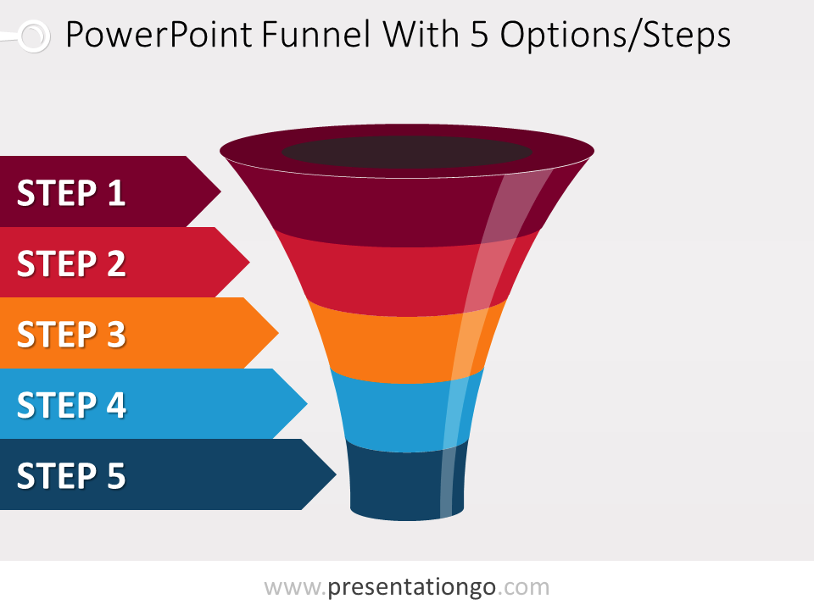
The Discipleship Funnel
How is evangelism different from discipleship?

Slide 7

The Discipleship Funnel
Come Level - they come for the fun, girls, friends
Grow level - they tolerate spiritual things as they have fun
Disciple Level - take the initiative for their spiritual growth
Develop Level - willing to help other people grow
Multiplier Level - become leaders to help others come
5 levels
Notes:
----- Meeting Notes (9/6/13 23:31) -----
We want ready made Christians! Yet here are the 5 steps.

Slide 8
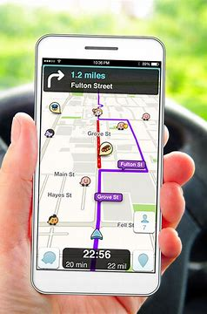
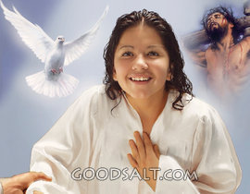
(GPS) God Positioning System - Acts 2:38,39
³⁸ Peter replied, "Repent and be baptized, every one of you, in the name of Jesus Christ for the forgiveness of your sins. And you will receive the gift of the Holy Spirit.
³⁹ The promise is for you and your children and for all who are far off-for all whom the Lord our
God will call." (NIV)
The Gift of the Holy Spirit – Rom. 12, 1 Cor. 12
Notes:
----- Meeting Notes (9/6/13 23:31) -----
The three gifts to His disciples - the promise

Slide 9
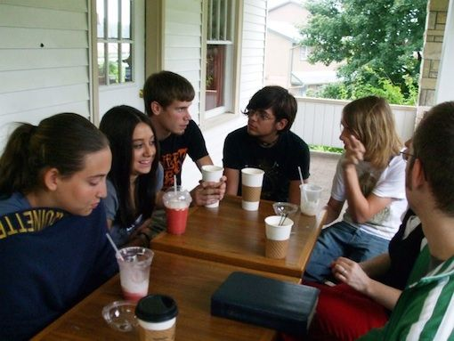
Breakout Time
Why is discipleship so important for today’s young people?

Slide 10

Visibility Factor Faith in visible action
(Postmoderns want to experience faith)
Fellowship – Lunch Pots
Scripture – Elizabeth Mornings
Praying – Honduras Project / Short Prayer
Serving – (enable or not)

Slide 11

Breakout Time
Why is the
Visibility Factor
Important?
Fellowship
Reading
Praying
Serving

Slide 12

Time to wrap it up!
Modernism
Postmodernism
Techno-postmodern Approaches

